Slide 2
Inter-Integrated Circuit
Communication Protocol

Slide 3
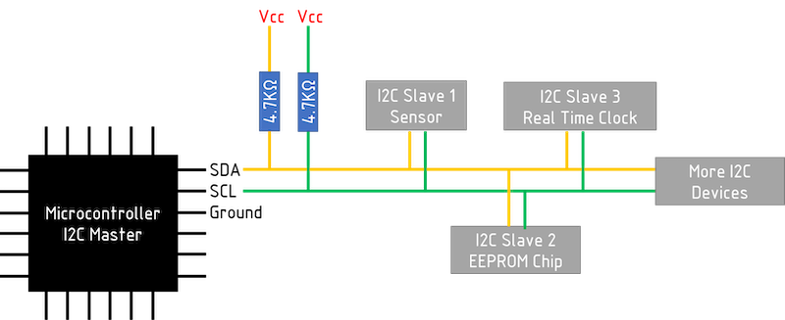
Understanding the I2C Protocol

Slide 4
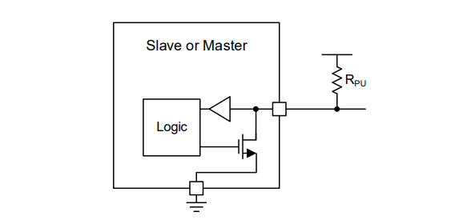
Basic Internal Structure of SDA/SCL Line

Slide 5
Magnetic Encoder
Quadrature Encoder System

Slide 6
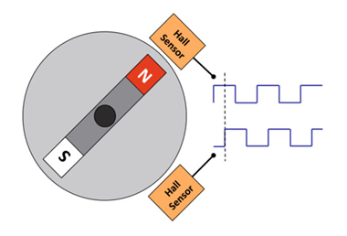
Structure of the Magnetic Encoder
Permanent magnet is magnetized in the radial direction.
Hall effect sensors detect the strength of the horizontal magnetic field.
Detects rotational position as changes in magnetic field.

Slide 7
Structure of the Magnetic Encoder
Hall effect sensors detect the
strength of the
horizontal magnetic field.
Permanent magnet is
magnetized in the radial direction.

Slide 8
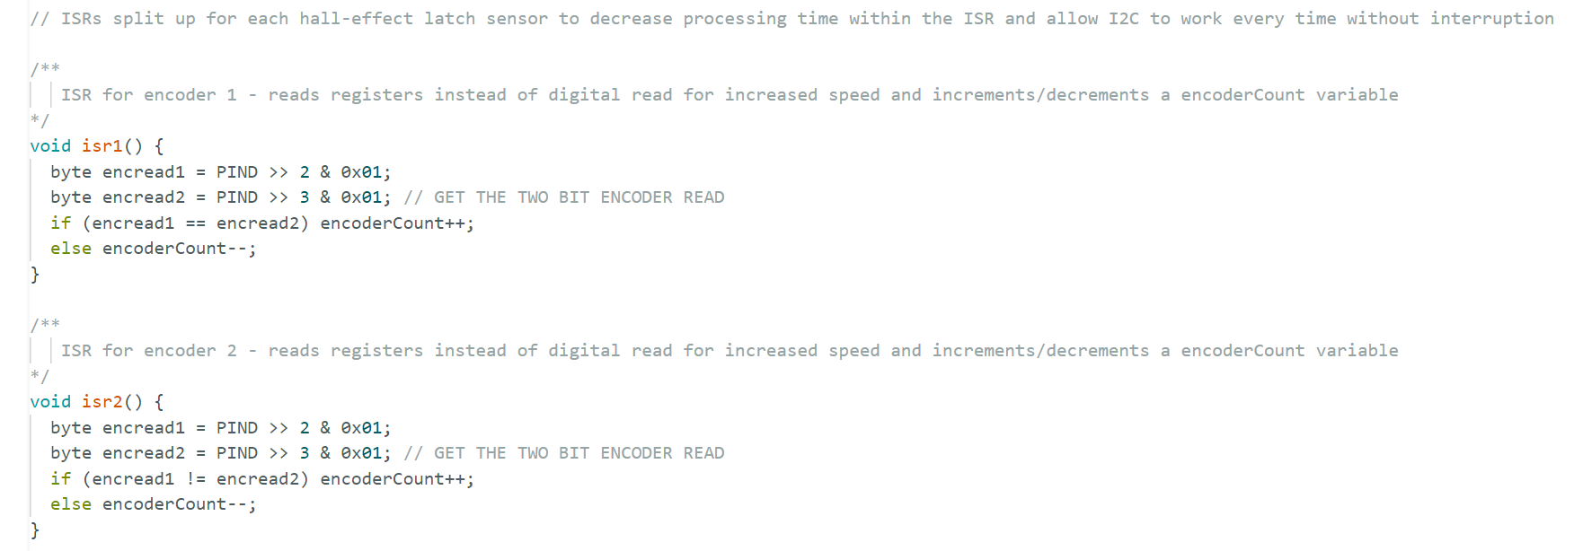
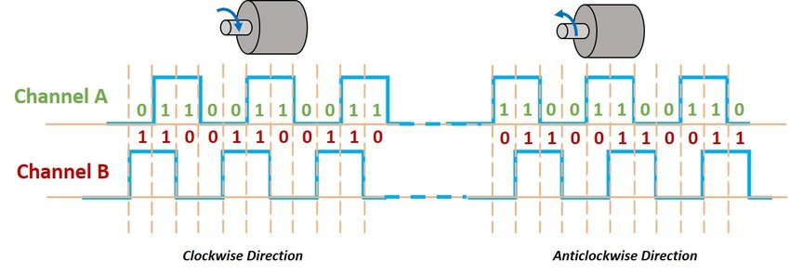
Interpretation of Encoder data
Signals are out-of-phase by 90-degrees

Slide 9
Motion Profiles

Slide 10

Triangular Profile-Quick, Point-2-Point Motion
Triangular
Calculations
Average Velocity:
$$v_{avg}=\frac{d_{t}}{t_{t}}$$
Max Velocity:
$v_{max}=2 ∗v_{avg}$
Total Distance:
$d_{t}= \frac{1}{2} ∗t_{t}∗v_{max}$
Velocity
Vmax
Vavg
Ta
Td
Time

Slide 11
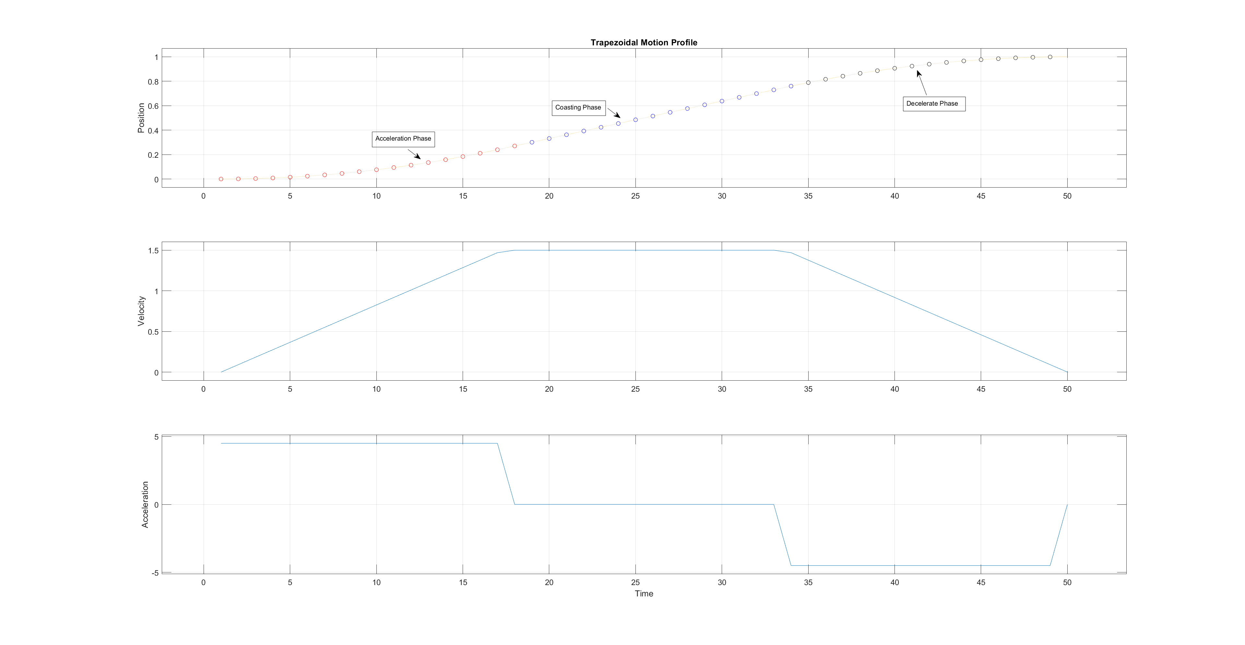
Trapezoidal Profile-Steady, Constant Velocity Motion

Slide 12
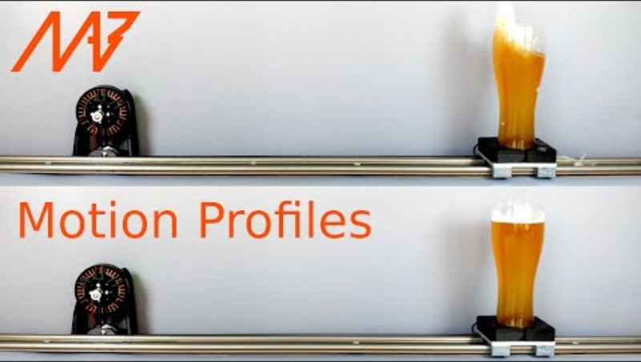
Motion Profiles

Slide 13

Trapezoidal Profile
Triangular
Calculations
Average Velocity:
$$v_{avg}=\frac{d_{t}}{t_{t}}$$
Max Velocity:
$v_{max}=1.5 ∗\frac{d_{t}}{t_{t}}$
Total Distance:
$d_{t}= \frac{2}{3} ∗t_{t}∗v_{max}$
Velocity
Vmax
Ta
Tc
Td
Time

Slide 14
Smart Motor Driver

Slide 15
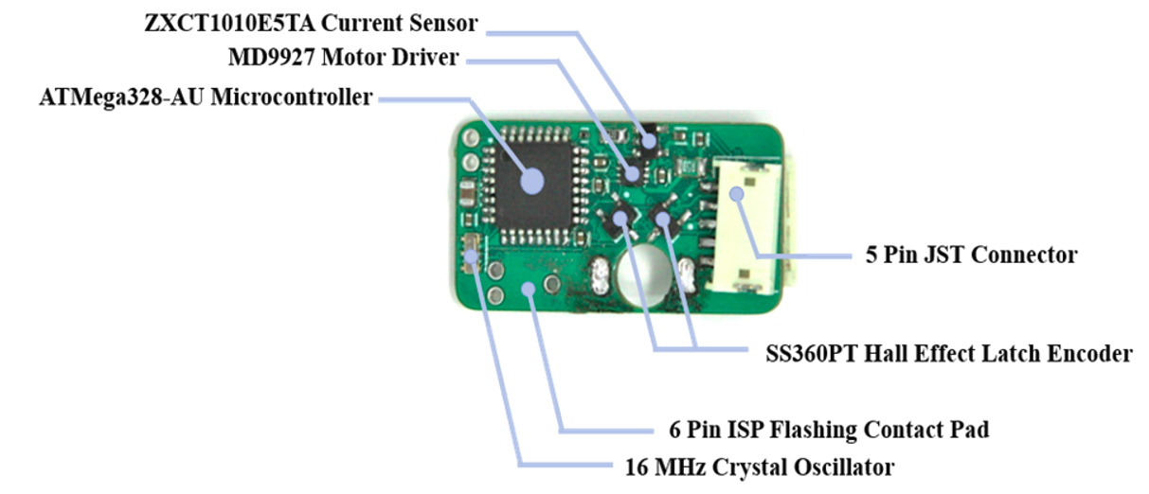
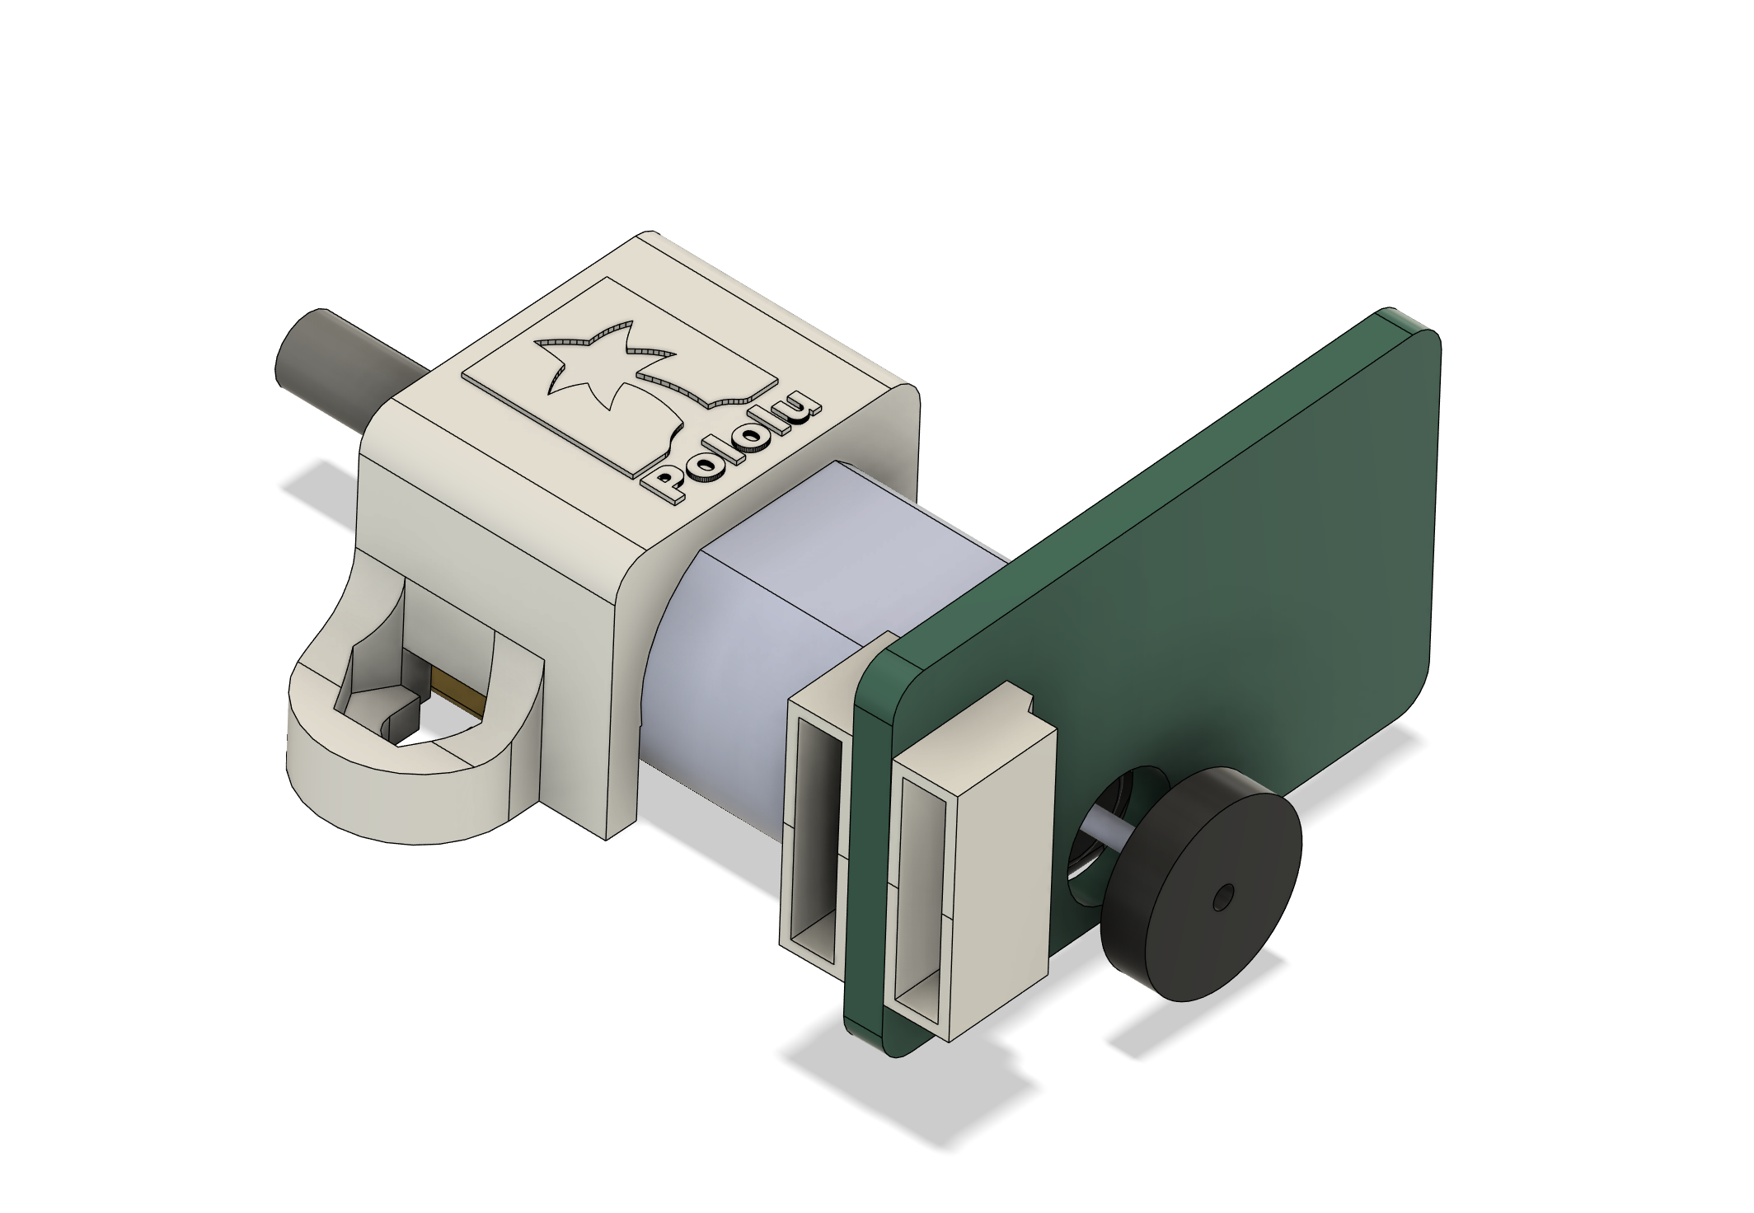
Smart Motor Driver
Permanent magnet is
magnetized in the radial direction.

Slide 16
Setup Phase:
Arduino Uno opens an I2C bus, address 0x07, to the Smart Motor Driver to read the encoder values.
2 interrupt service routines keep track of the Quadrature Encoder values.
Controlling Smart Motor Driver:
When the Smart Motor Driver receives a command from the Uno, it stores the data in an integer called I2CStatus

Slide 17
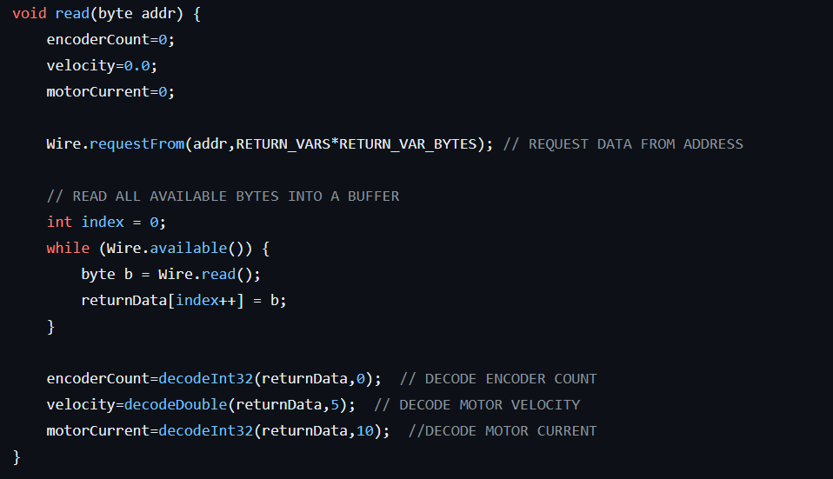
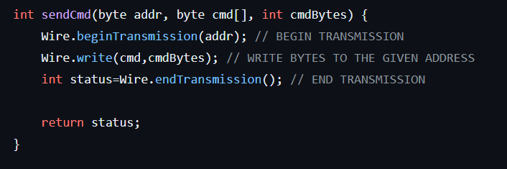
Communication between Uno & Motor Driver
Requesting data over I2C bus
Sending Pos. & Vel. Commands over I2C

Slide 18
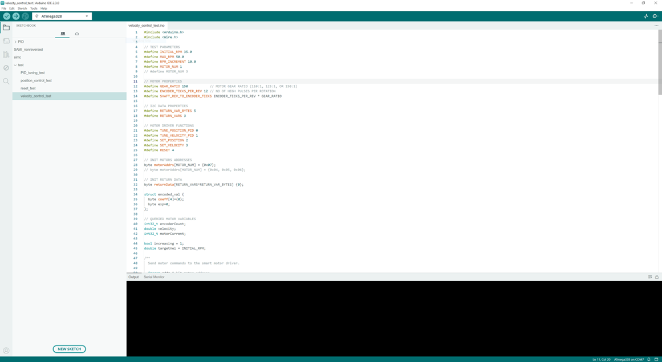

Slide 19
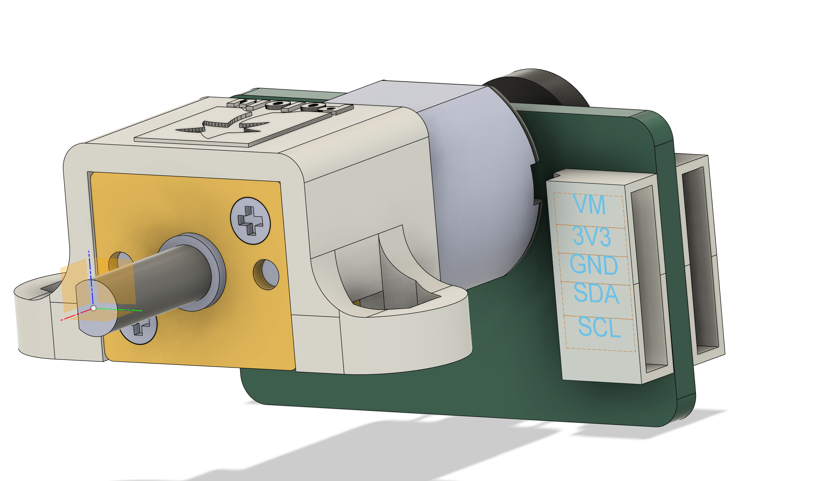
Connection diagram
VM
3V3

